Slide 1
Capital Improvement Project Requests
FY 2021-2022
Homa Anooshehpoor, Administrator Food and Nutrition Division

Slide 2
NDA CIP Request
The Nevada Department of Agriculture (NDA) is requesting to build a new freezer and cold storage in our southern Headquarters.
Southern Warehouse Cold Storage Project
Priority level: 1
Total request: $1,397,849
Background: NDA manages two State warehouses in Reno and Las Vegas that store and distribute USDA food for schools, community organizations, and Tribal communities.

Slide 3
Southern Warehouse Services
Crucial programs such as National School Lunch Program (NSLP), Commodity Supplemental Foods Program (CSFP), Child and Adult Care Food Program (CACFP), and Summer Food Service Program (SFSP) are directly affected by the need for adequate freezer storage.

Slide 4
Southern Warehouse Services
These programs provide access to nutritious food for Nevada’s children, families and elderly and NDA cannot participate in them without cold food storage which could lead to compromised access to food to children, elderly and other citizens within our state in need of food assistance.
For example:
CSFP: 4,938 seniors per month in 2019
NSLP: 1,580,735 meals served in 2019

Slide 5
Southern Warehouse - Current
The Las Vegas warehouse contains 5,150 sq. feet of dry storage space but has no cold storage capacity.
NDA currently leases 2,250 sq. feet of cold storage space from Las Vegas Cold Storage/Reddy Ice for $68,000 per year.
This arrangement poses challenges for NDA staff when monitoring inventory and tracking best-if-use-by (BIUB) dates.

Slide 6
Southern Warehouse - Current
Using an off-site, private facility can result in food losses that could be avoided through in-house control of cold storage inventory.
Traveling off-site to LVCS also increases the wear and tear on trucks and tires and takes additional staff time.
Additional miles: approximately 672 annually at an estimated cost of $1,223*
Staff time: approximately 30 hours administrative time at a cost of $1,126 and 207 hours spent in travel time and time at LVCS facility at a cost of $5,276.
(*Per mile estimate of $1.82 based on American Transportation Institute)

Slide 7
Proposed Solution
NDA will work with SPWD to develop an on-site cold storage facility comprised of an engineered concrete pad to hold six (6) cold storage containers
Project Cost: $1,397,849
Includes design, professional services, and construction costs for concrete pad, fork-lift ramp, electrical trench, shade structure, and purchase of six cold storage containers.

Slide 8
Current Warehouse Dry Storage

Slide 9
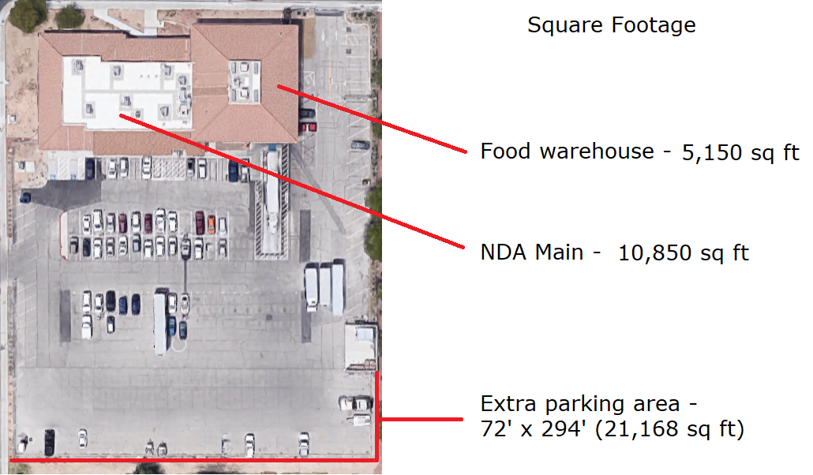
Las Vegas Property & Proposed Location
Proposed Location For Cold Storage

Slide 10
Proposed Cold Storage Location

Slide 11
Consequences If Not Approved
Due to outsourcing cold storage, NDA has limited control over the food, processes, and procedures, which may lead to loss of food and non-compliance with federal standard operating procedures. This could put program funding at risk.
Having a refrigeration/freezer facility on site at the southern Headquarters would not only save money based on nonrenewal of a vendor contract, but also our employees’ time would be allocated more efficiently, and delivery times could potentially be shortened.

